Slide 1
Contribution of Federal Standards Toward 6th Plan Efficiency Goals
Conservation Resources Advisory Committee Meeting
June 4, 2014

Slide 2
Sixth Plan Resource Portfolio
Source:http://www.nwcouncil.org/energy/powerplan/6/2010-01/
*Expected Value Build Out. Actual build out schedule depends on future conditions

Slide 3
Conservation Goals From 6th Plan Resource Portfolio 1200 aMW Over Five Years, 5845 aMW Over 20 Years

Slide 4
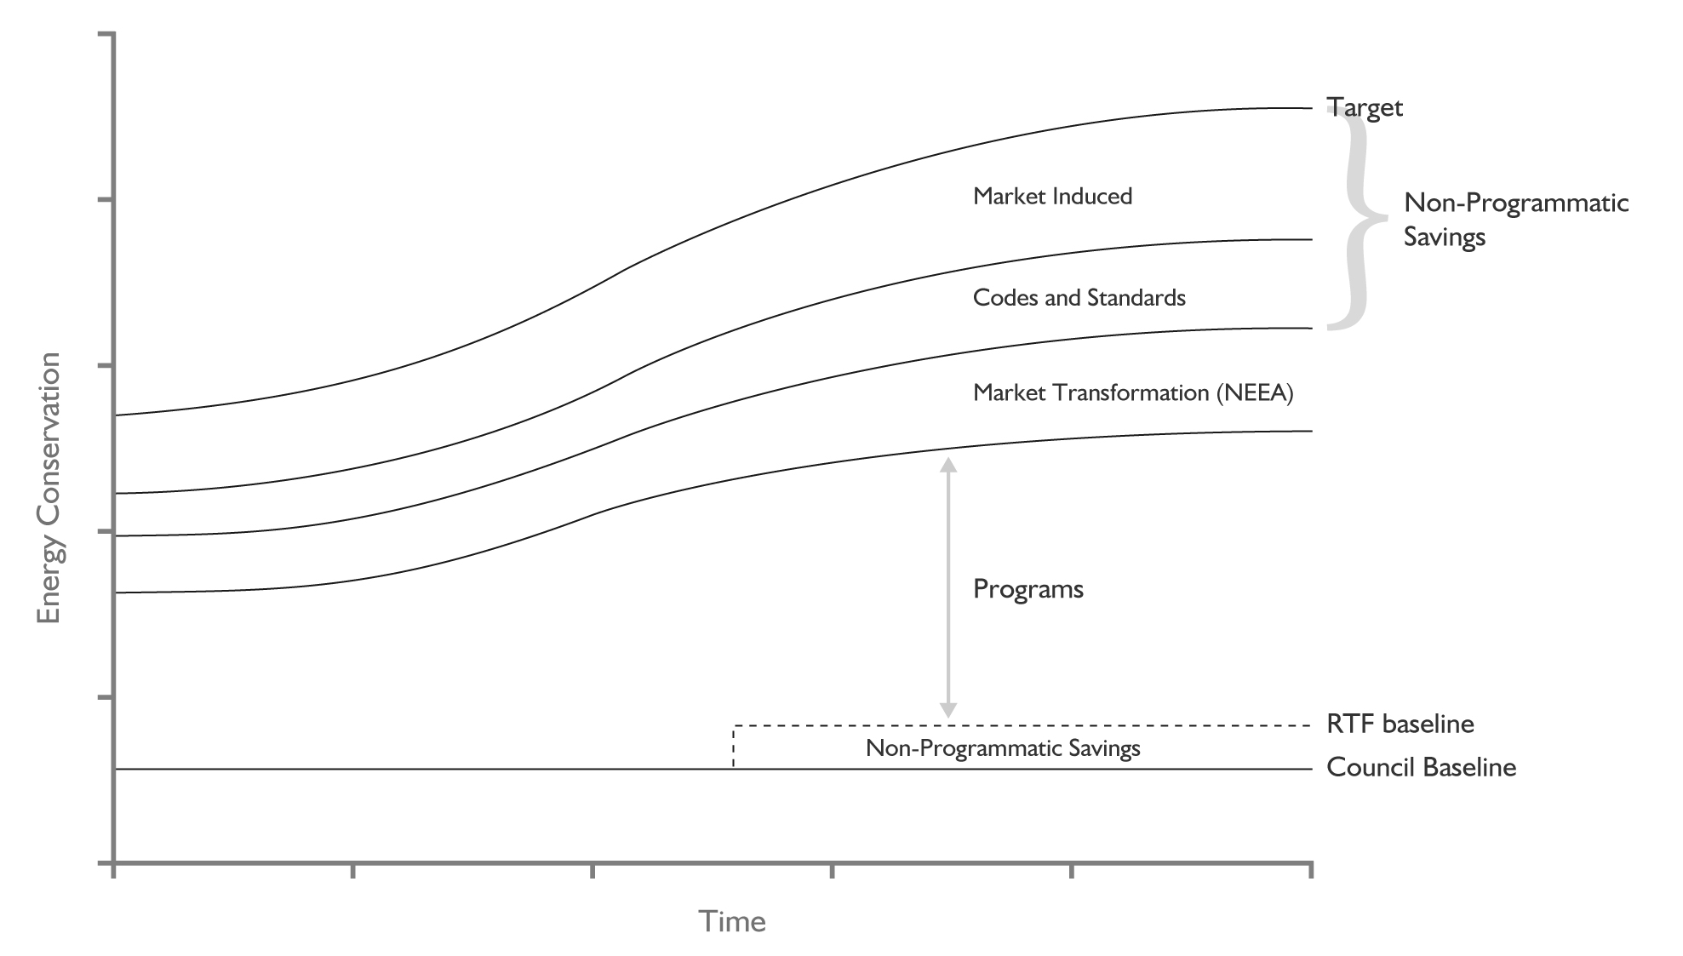
What Counts Towards Targets?

Slide 5
Reported BPA, ETO, Utility & NEEA Programs Exceed Targets
780 aMW thru 2013!

Slide 6
What’s The Contribution of Federal Standards?

Slide 7
6th Plan Conservation Goals
1660 aMW
2015-2019
1200 aMW
2010-2014

Slide 8
How Much Will New Federal Standards (and State Codes) Contribute Meeting 6th Plan Goals?
Codes and Standards Primarily
Provide Lost-Opportunity Savings

Slide 9
Residential Appliance and Equipment Savings From Five Federal Standards That Take Effect by 2015 Are Just Under 350 Average Megawatts by 2029

Slide 10
However, The Estimated Contribution of Residential Appliance and Equipment Standards Savings to Sixth Plan Conservation Goals Is Small Over The Near Term
125 aMW
2015-2019
1 aMW
2010-2014

Slide 11
Commercial & Industrial Equipment Savings From Eight Federal Standards That Take Effect by 2015 Are Nearly 280 Average Megawatts by 2029

Slide 12
Commercial and Industrial Equipment Standards Savings Are More Significant Than Residential Over The Near Term
74 aMW
2015-2019
38 aMW
2010-2014

Slide 13
Lighting Standards
Lighting Standards in Sixth Plan forecast
General Service Incandescent (2012)
Mercury Vapor (2008)
Seven Standards since Sixth Plan (Effective Dates)
General Service Fluorescent Lamps (2012)(2014)
Fluorescent Ballasts (2015)
Metal Halide Fixtures (2012)
Halogen Reflector Lamps (2012)
Candelabra Lamps (2012)
Ceiling Fan Light Kits (2010)
Torchieres (2010)

Slide 14
Lighting Savings From Seven Federal Standards That Take Effect by 2015 Are Over 155 Average Megawatts by 2029

Slide 15
Federal Lighting Standards Have the Greatest Near-Term Impact (Because Lighting Equipment Has a Short-Lifespan)
62 aMW
2010-2014
65 aMW
2010-2014

Slide 16
Federal Standards Are Estimated to Save Just Over 100 aMW by 2014 and 265 aMW between 2015-2019
265 aMW
2010-2014
102 aMW
2010-2014

Slide 17
Total Savings Forecast from Federal Standards Add Up to 780 Average Megawatts by 2029

Slide 18
Federal Standards Adopted The Since Sixth Plan Capture One Quarter of The Twenty-Year Lost-Opportunity Potential

Slide 19
How Much Will New Federal Contribute Meeting 6th Plan Goals?

Slide 20
Regional Retrofit and Lost Opportunity Savings Goals, Net of Standards

Slide 21
Some Caveats
Estimates Subject to Further Review
Workbooks to be posted for review
Overlap of State Codes & Fed Standards
Non-Res Lighting & HVAC Equipment
Need to tease apart to avoid double count
Interaction between Codes & Standards
Hours of operation for lighting (WA code)

Slide 22
Next Up: Update Progress Towards 6P Targets
Adjust utility-reported savings to 6P baseline
Remove early-retirement savings from reports
Unit counts or consumption adjustments
Identify incremental non-program savings
Non-Residential lighting
Residential clothes washers & heat-pumps
Others where data exist
Account for overlap & interaction

Slide 23
End

